Slide 1
Backpropagation in Practice

Slide 2
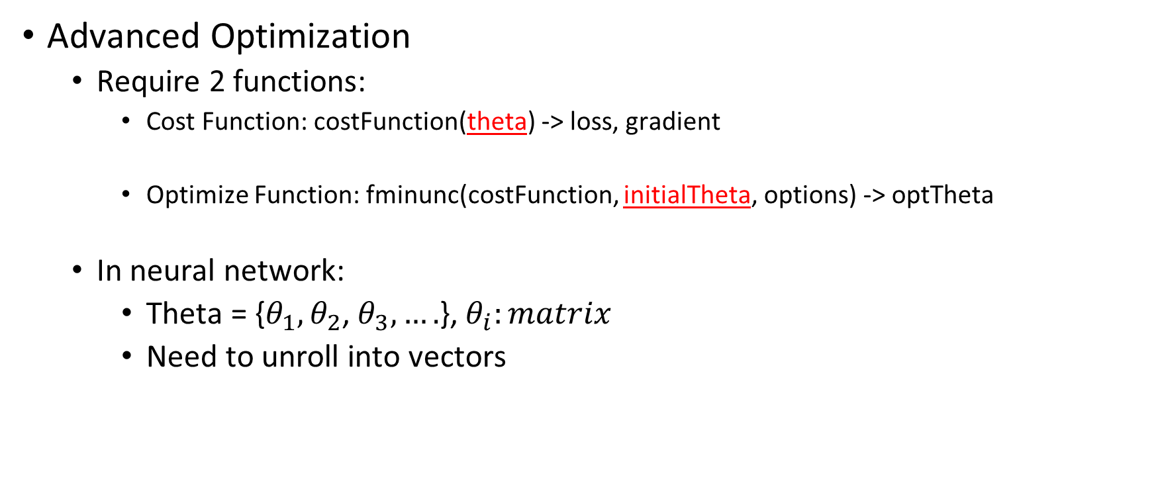
Unrolling Parameters
Advanced Optimization
Require 2 functions:
Cost Function: costFunction(theta) -> loss, gradient
Optimize Function: fminunc(costFunction, initialTheta, options) -> optTheta
In neural network:
Theta = {$θ_{1},θ_{2}$, $θ_{3},….$}, $θ_{i}:matrix$
Need to unroll into vectors
Vector

Slide 3
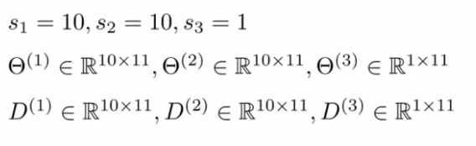
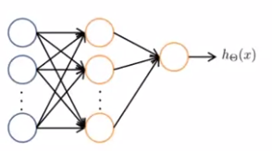
Unrolling Parameters
Example
Python
theta = np.concatenate((theta1.ravel(), theta2.ravel(), theta3.ravel()))
D = np.concatenate((d1.ravel(), d2.ravel(), d3.ravel()))
theta1 = theta[0:110].reshape(10, 11)
theta2 = theta[110:220].reshape(10, 11)
theta3 = theta[220:231].reshape(1, 11)

Slide 4
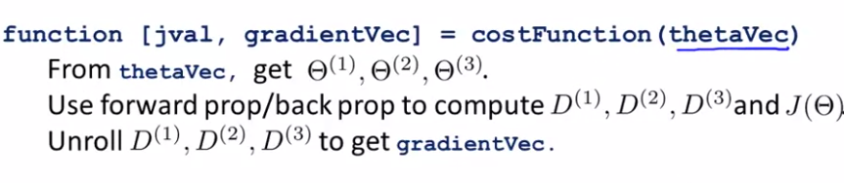

Unrolling Parameters
Have initial parameters $θ_{1},θ_{2},θ_{3}$
Unroll into vectors to pass to optimize function fminunc

Slide 5
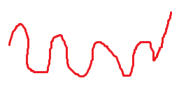

Random Initialization
For gradient descent and advanced optimization method, we need to set initial $θ$
Where???

Slide 6
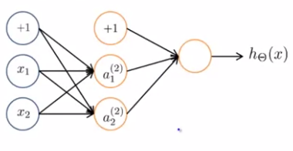


Random Initialization
Zero initialization
$a_{1}^{(2)}=a_{2}^{(2)}⇒ δ_{1}^{(2)}=δ_{2}^{(2)}$
$D_{1}^{(2)}=D_{1}^{(2)}⇒θ_{1}^{(2)}=θ_{2}^{(2)}$
All hidden units compute the exact same function

Slide 7


Random initialization
Symmetry breaking
Normally, $ε=1$

